Slide 1
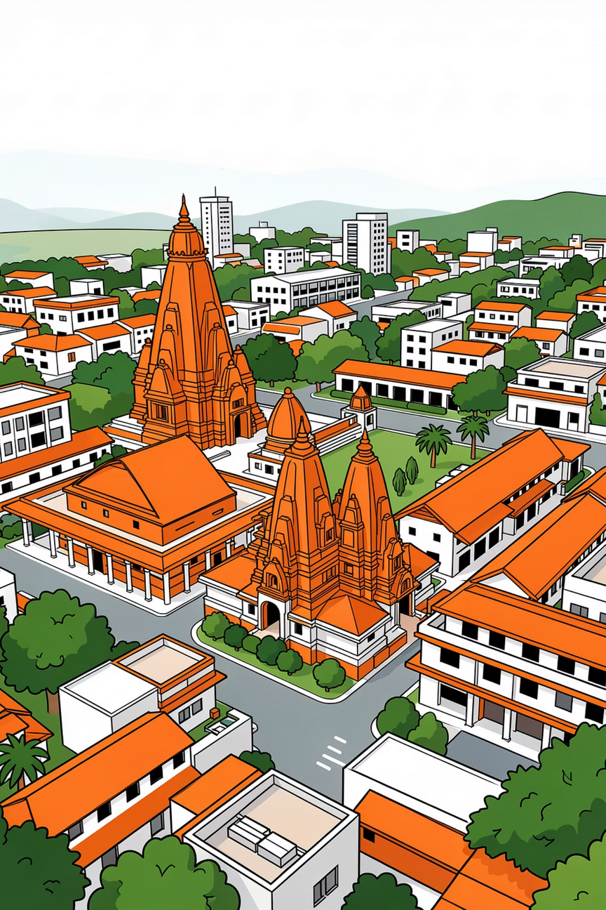
Pixel-Level Land Use–Land Cover Transition Analytics for Tirupati
AI for Sustainable Urban Development & Smart City Governance
Hackathon Project Presentation
Focus Area: Tirupati District
Technologies: Remote Sensing, AI, Geospatial Analytics
Goal: Decision-ready intelligence for urban planners and policymakers
Notes:
1

Slide 2
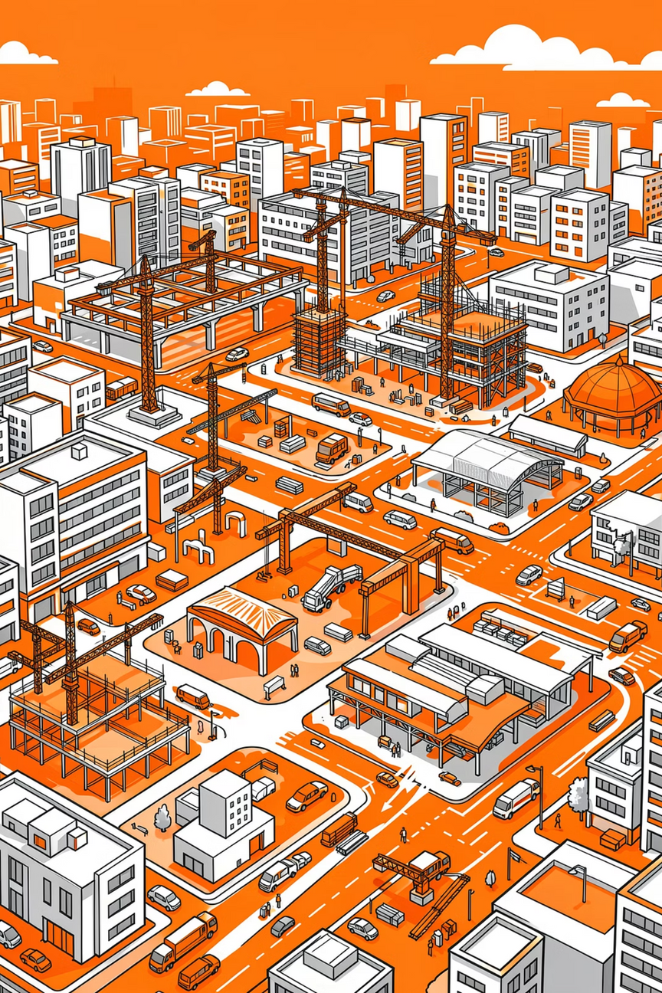
Background & Context
Why This Problem Matters
Tirupati is experiencing rapid urban expansion due to:
Pilgrimage-driven population growth
Infrastructure development
Tourism and associated services
These changes are transforming natural and agricultural land into built-up areas
Traditional land monitoring methods lack:
Pixel-level precision
Temporal comparison
Quantified confidence in results
➡️ Result: Urban planning decisions are often reactive instead of data-driven
Notes:
2

Slide 3
Problem Statement
Core Challenge
Develop an automated AI-based framework that can:
System Output
The system must convert raw satellite data into:
Detect pixel-wise land use / land cover (LULC) changes
Compare two different time periods
Quantify what changed, where it changed, and how confidently it changed
Actionable statistics
Visual insights for governance
Notes:
3

Slide 4
Objectives
What We Aim to Achieve
Remote Sensing & Geospatial Analytics
Artificial Intelligence
Decision Support
AI-based classification and change detection
Confidence scoring and probabilistic transition estimation
Transition matrix generation
Visual and statistical summaries for policymakers
Pixel-level LULC classification
Accurate spatial alignment of multi-temporal satellite imagery
Notes:
4

Slide 5





Land Use / Land Cover Classes
Classification Categories
Each pixel is classified into one of five LULC classes:
Forest
Water Bodies
Agriculture
Dense and sparse vegetation cover
Rivers, lakes, reservoirs
Cropland and plantations
Barren Land
Built-up
Open land with minimal vegetation
Urban and infrastructural areas
➡️ These classes help quantify urban expansion and environmental loss
Notes:
5

Slide 6
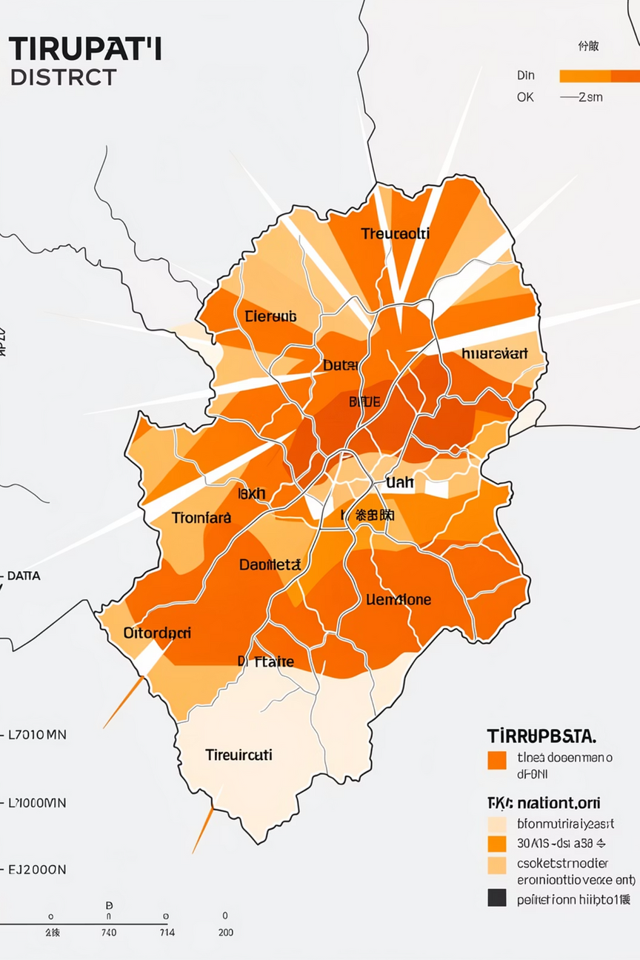

Dataset Used
Data Sources & Inputs
Tirupati District Boundary (.shp)
Satellite Imagery
Auxiliary Data
Landsat (multi-temporal optical data)
Sentinel-2 (high-resolution multispectral data)
Sentinel-1 (SAR data for robustness)
Open satellite datasets to improve accuracy
Defines the Area of Interest (AOI)
➡️ All datasets are open, scalable, and reproducible
Notes:
6

Slide 7
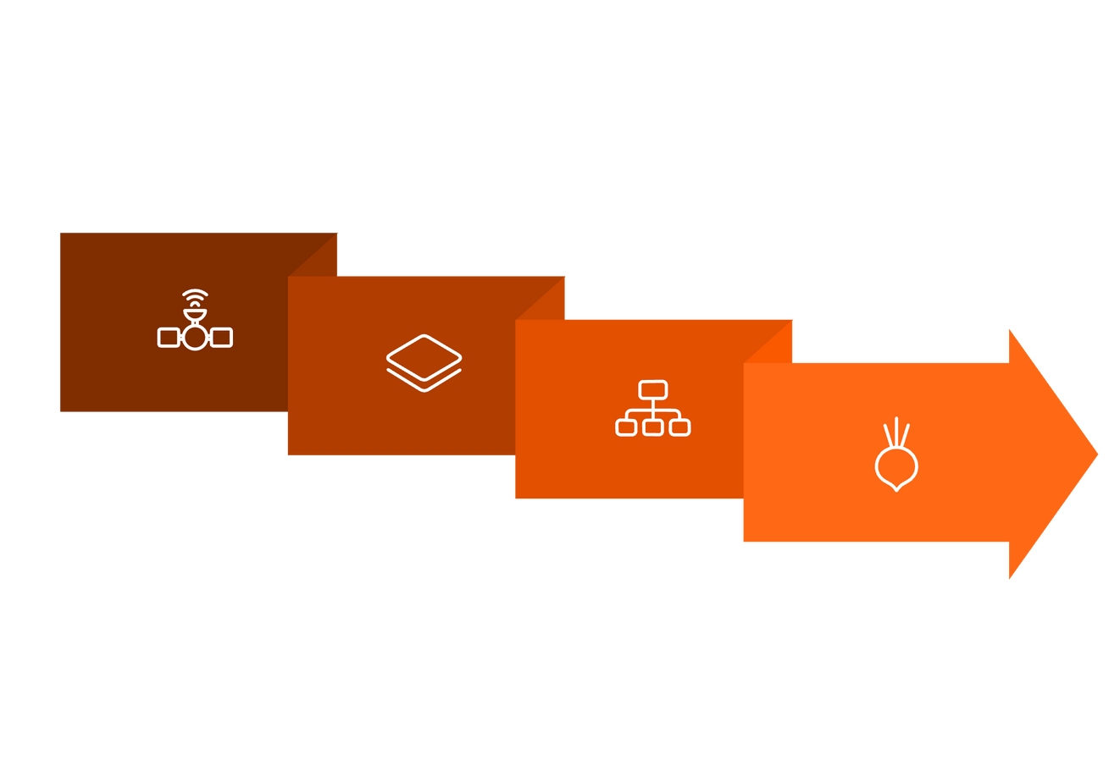




Methodology Workflow
End-to-End AI Pipeline
Preprocess
Detect
Acquire
Classify
➡️ Fully automated and scalable GeoAI workflow
Notes:
7

Slide 8
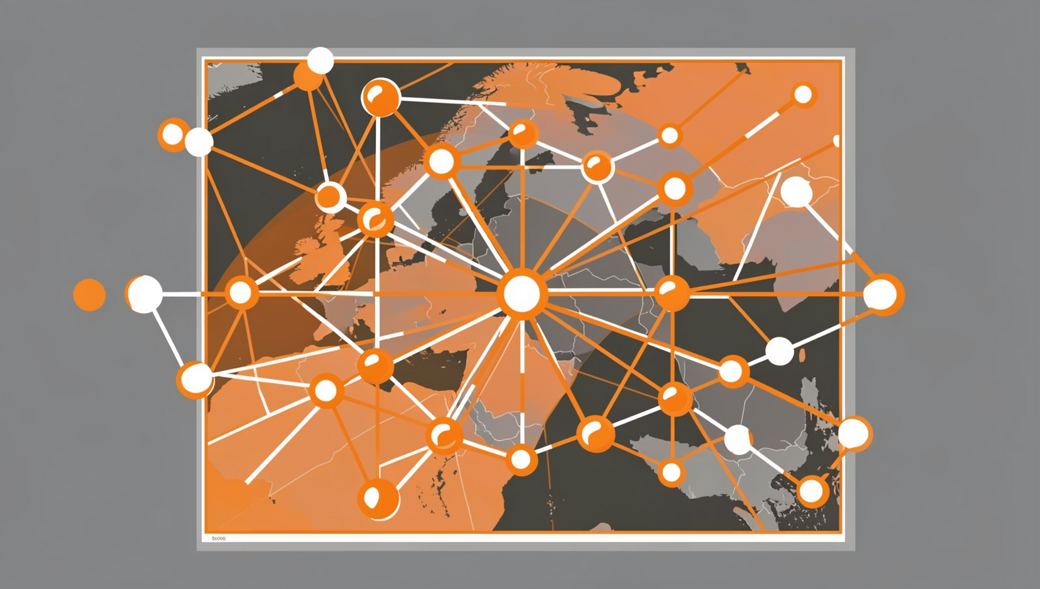
AI & Machine Learning Approach
Intelligence Behind the System
AI models classify each pixel independently
Temporal comparison identifies:
No change
Class-to-class transition (e.g., Forest → Built-up)
Model outputs:
Classification label
Confidence score
Probability of transition
➡️ Ensures interpretability and reliability, not just predictions
Notes:
8

Slide 9



Transition Matrix & Analytics
Understanding Land Transformation
Matrix Summary
Example Insights
Enables Analysis
A transition matrix summarizes how much area moved from one class to another and the direction and magnitude of land conversion
Agriculture → Built-up
Forest → Barren Land
Area statistics
Percentage change analysis
➡️ Converts pixel-level data into policy-ready metrics
Notes:
9

Slide 10
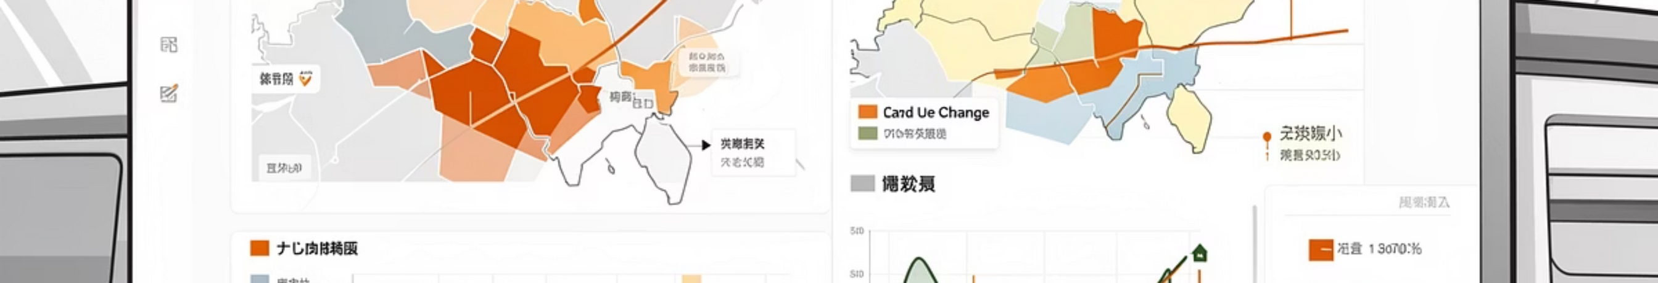
Visual Outputs
Change Intelligence Products
01
02
03
Pixel-level LULC maps for both time periods
Change detection overlays highlighting transitions
Confidence and probability maps showing certainty levels
04
Spatial patterns of urban growth and vegetation loss
➡️ Makes complex data visually intuitive and actionable
Notes:
10

Slide 11




Dashboard & Decision Support
Interactive Visualization System
Multi-layer Map Toggles
Temporal Comparison Tools
Explore different LULC layers such as urban, forest, and water bodies, with options to overlay and compare them.
Visualize changes between two distinct time periods, identifying areas of growth, decline, or stability.
Transition Analytics Panel
One-click Export
Area statistics: Quantified changes in square kilometers for each LULC class.
Class-wise conversion percentages: Detailed breakdown of what changed from and to what.
Maps: High-resolution images of LULC changes and overlays.
Tables: Raw data and summary statistics in CSV format.
Reports: Automated summaries for quick policy review.
➡️ Designed for urban planners, administrators, and policymakers to enable informed decision-making.
Notes:
11

Slide 12



Impact, Innovation & Conclusion
Impact
Innovation
Conclusion
Enables data-driven urban planning
Supports environmental governance
Aligns with smart city initiatives
Pixel-level confidence-aware change detection
Fully automated GeoAI pipeline
Scalable across districts and states
Transforming Tirupati's urban development through AI-powered geospatial intelligence
Decision-ready intelligence for sustainable growth
Notes:
12

